Slide 1


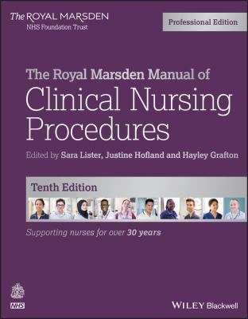
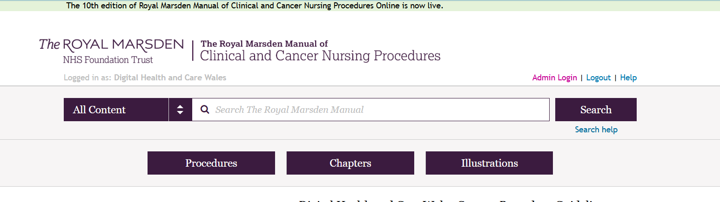
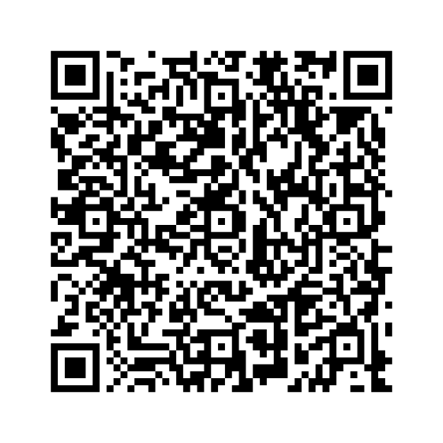


Mewngofnodwch trwy OpenAthens GIG Cymru neu o rwydwaith GIG Cymru
Access with NHS Wales OpenAthens or from the NHS Wales nework
https://elh.nhs.wales/guidelines/guidelines-pages/royal-marsden-manual-of-clinical-and-cancer-nursing-procedures-10th-edition/

Slide 2
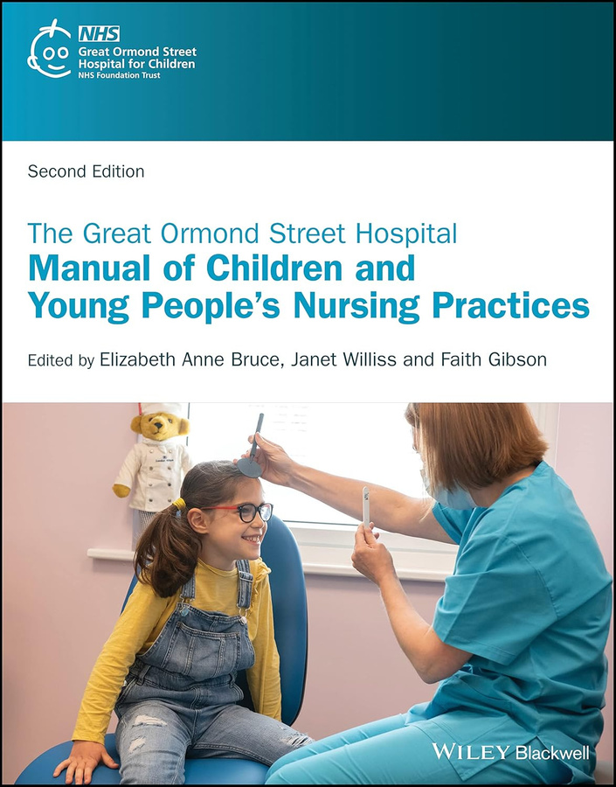
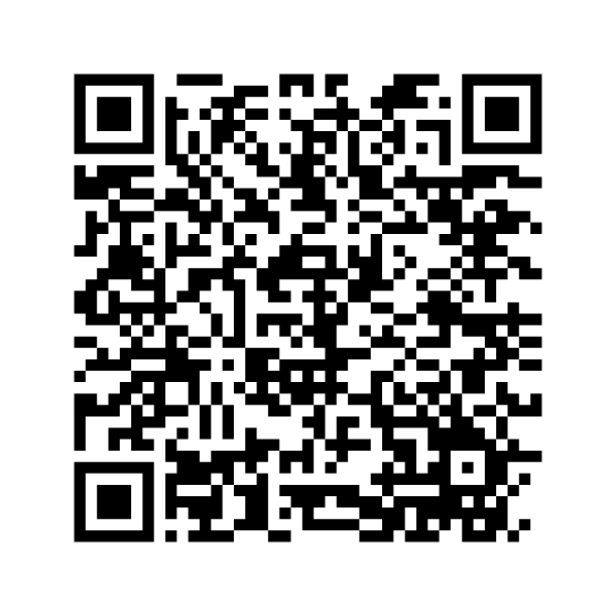
Mewngofnodwch trwy OpenAthens GIG Cymru neu o rwydwaith GIG Cymru
Access with NHS Wales OpenAthens or from the NHS Wales nework
https://elh.nhs.wales/guidelines/guidelines-pages/great-ormond-street-hospital-manual/

Slide 3

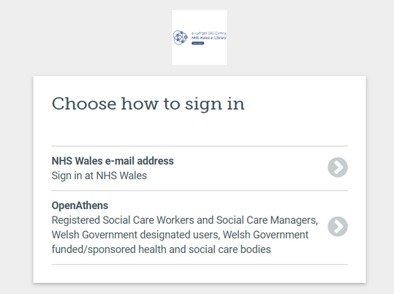
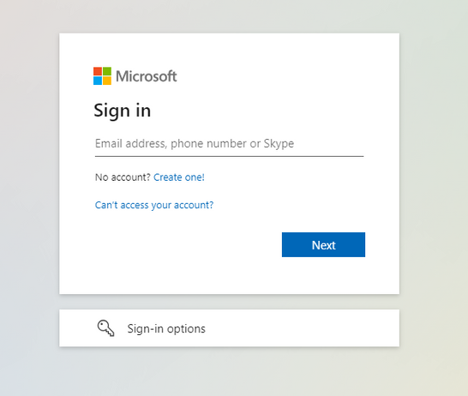
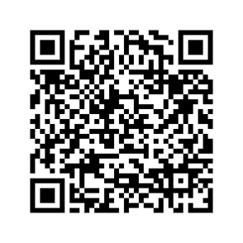
Oes gennych chi gyfeiriad e-bost GIG Cymru?
Os mai ‘ydw’ yw’r ateb, mae gennych bopeth sydd ei angen arnoch i gael mynediad ar unwaith at adnoddau e-Lyfrgell GIG Cymru.
Do you have an NHS Wales email address?
If the answer is yes, you have everything you need to instantly access NHS Wales e-Library resources.
https://elh.nhs.wales/sign-in/nhs-wales-users/registration-process/
Mewngofnodi
Sign In
Mewngofnodwch gyda "OpenAthens" i ddatgloi mynediad i adnoddau
Sign in with “OpenAthens” to get access to resources

