Slide 1

BMJ Best Practice
Local Guidelines Feature
Rachel Sully
NHS Wales e-Library and Knowledge Services Manager

Slide 2

What is BMJ Best Practice?
“BMJ Best Practice takes you quickly and accurately to the latest evidence-based information, whenever and wherever you need it. Our step by step guidance on diagnosis, prognosis, treatment and prevention is updated daily using robust evidence based methodology and expert opinion.”
The resource includes access to UK national guidelines, patient information, information on how to promote self-care/management as well as linking to the evidence to support evidence-based care. It can also be used for CME/CPD activity.
BMJ Best Practice is an evidence summary purchased by the NHS Wales e-Library and available to all NHS Wales employees and contract holders including students when on placement.
Access is instant when on the NHS Wales network or from home via OpenAthens using your NHS Wales email address and password or self-registration account. Users can also register for a personal account to download the apple or android app that can be used offline when internet access may be unavailable.
The current cost of the resource is: £125,882.89 inc VAT

Slide 3

BMJ Best Practice Demo
(via youtube)

Slide 4
Usage
BMJ Best Practice is already very well used within NHS Wales. Over August 2020 – July 2021, we saw:
62,135 topics accessed
31,530 sessions
This provided a cost per use of:
£1.63 per topic accessed
£3.13 per session

Slide 5
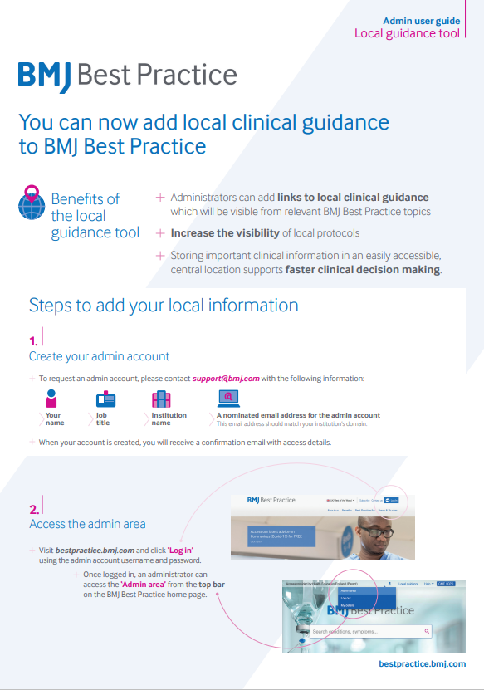
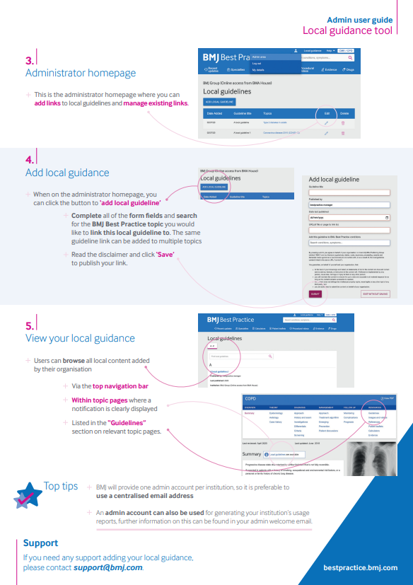
Local Guidelines feature
BMJ Best Practice has recently launched a unique local guidance tool, which would enable NHS Wales to add links to national Welsh clinical guidance/pathways and local NHS Wales Health Board/Trust guidance/pathways. This will mean that Welsh health and care professionals can access local content from within the BMJ Best Practice platform without interrupting their workflow.
This feature would meet many of the requirements listed in the Welsh Government Clinical Pathways Specification.

Slide 6
BMJ Best Practice Local Guideline Demo
(via youtube)

Slide 7

Requirements of the specification
Pathways from community…through to hospital setting
Patient/person facing information which clinicians can share with the patient/person
Target audience…range of health clinicians, professional practitioners and partners
Highly acceptable to practitioners
Contain clinical guidance on the assessment and management of clinical conditions
Administrative information on self-help/management
Access to diagnostics, specialist opinion, specialist treatment services
Easily accessible to all relevant users from any device
Publishing evidence-based clinical pathways by Health Boards/Trusts in Wales (not storing but could be stored on local intranets)
Describe the actions and triggers for referral on to specialist care
Provide training and programme support to each Health Board/Trust (in how to add local guidelines)
Must be easily accessible to all relevant users on any secure mobile device
Collect and share performance data (nationally and by Health Board/Trust)
Operational at time of bid
Provide one directory
Standard template (the template BMJ Best Practice uses could be utilised)
Hyperlinks to other national/international systems
Search
Intuitive directory indexing structure
Technical support
Unlimited number of concurrent users
Compliance with Welsh Language (BMJ Best Practice can be searched in Welsh)
Implementation (already implemented) can also be integrated with clinical systems
Information Governance and IT Security (already approved within DHCW)
Must not store or process any form of patient data
Provision of support and advice on engaging clinicians and users on the local rollout programme
Notes:
The system is already implemented, access in place for all NHS Wales and usage data collected quarterly
It is accessible from any device at work or at home
It can link to local guidance that is hosted elsewhere, e.g. on HB/Trust intranet sites

Slide 8

Requirements of the specification
Storing…evidence-based clinical pathways by Health Boards/Trusts in Wales (BMJ BP cannot host pathways but the pathways could be hosted elsewhere on local intranet sites or in a repository)
Respond rapidly to Health Boards/Trusts when changes to pathways are required (it would be responsibility of the admin to update links to guidance)
Users of pathways will be able to provide live feedback on pathway quality
Provide training and programme support to each Health Board /Trust to support pathway development
Able to accommodate local modifications of clinical pathways via an agreed approval process
Live (interactive) pathways
Track, record correspondence and decisions relating to the development, establishment and continuation of any pathway for audit and governance purposes
Provision of a dedicated local nominated clinical role for support Operational at time of bid
Provision of a dedicated nominated support role for technical writing to support each Health Board’s internal team
Support for the national lead for all Wales Clinical Pathways for clinical pathway development and support
Archive and retain any pathways
Individual usage data
Notes:
BMJ Best Practice cannot store the pathways
The supplier cannot support the creation, updating and archiving of pathways or present them in a live interactive way
The supplier could not facilitate feedback
The supplier cant provide individual usage data

Slide 9
Further Benefits
BMJ Best Practice is already implemented, access available for all NHS Wales through a variety of devices
The resource can be integrated with clinical systems including Welsh Clinical Portal, Welsh Patient Referral Service
An icon to the resource can be put on all desktops to support quick access
It’s evidence based, includes patient information that is copyright clear to share in print or electronically
The local guideline feature is available now and could be rolled out in a day for immediate population

