Slide 1






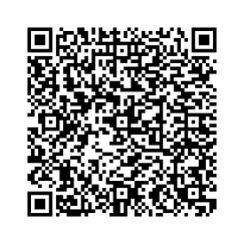

Maudsley
Mae'r teitlaui 'ma gyd ar gael yn LibrarySearch, y catalog llyfrgell a rennir yn GIG Cymru.
These titles are all available at LibrarySearch, the shared library catalogue in NHS Wales.
e-Lyfrau
e-Books
Mewngofnodwch gyda "OpenAthens" i ddatgloi mynediad i adnoddau
Sign in with “OpenAthens” to get access to resources

Slide 2
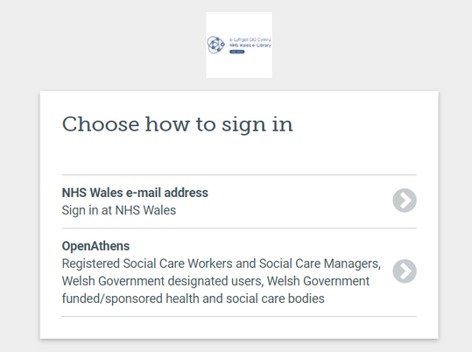
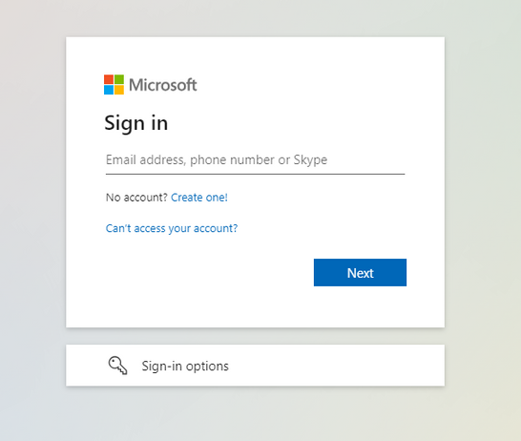
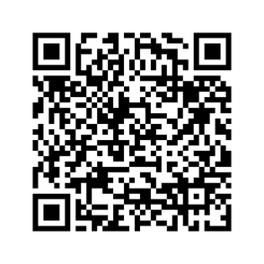
Oes gennych chi gyfeiriad e-bost GIG Cymru?
Os mai ‘ydw’ yw’r ateb, mae gennych bopeth sydd ei angen arnoch i gael mynediad ar unwaith at adnoddau e-Lyfrgell GIG Cymru.
Do you have an NHS Wales email address?
If the answer is yes, you have everything you need to instantly access NHS Wales e-Library resources.
https://elh.nhs.wales/sign-in/nhs-wales-users/registration-process/
Mewngofnodi
Sign In
Mewngofnodwch gyda "OpenAthens" i ddatgloi mynediad i adnoddau
Sign in with “OpenAthens” to get access to resources

